Slide 1


Software Design & System Design
An overview Code Principles
Otávio Santana, Founder
otavio@os.expert

Slide 2
Introduction
Topics on this class
Why?
SOLID principles
DRY (Don't Repeat Yourself)
KISS (Keep It Simple, Stupid)
YAGNI (You Aren't Gonna Need It)
Separation of Concerns
Composition over Inheritance
Law of Demeter (Principle of Least Knowledge)
Coupling and Cohesion
Encapsulation
Code readability and maintainability
Testability and TDD (Test-Driven Development)
Refactoring and code smells

Slide 3
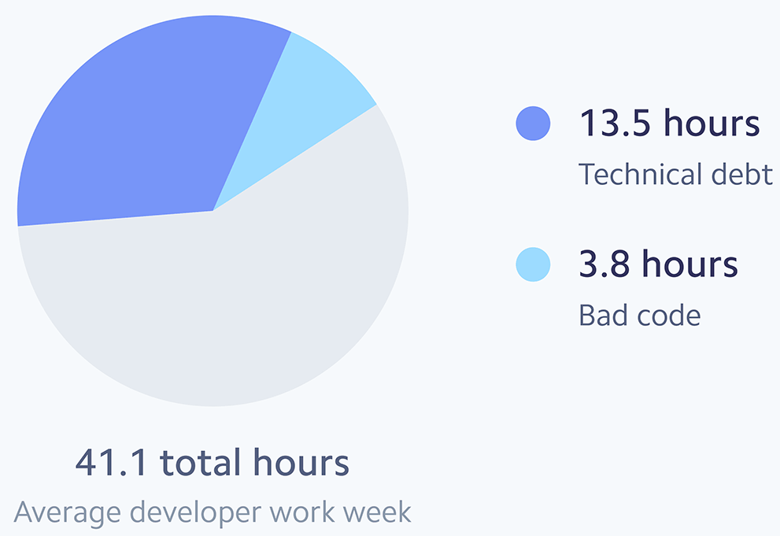
The $85 Billion Cost of Bad Code
42% of their time dealing with technical debt
41.1 hours weekly developer workload
17.3 hours lost to rework
13.5 hours on tech debt
3.8 hours on bad code
9.25% loss from poor code

Slide 4
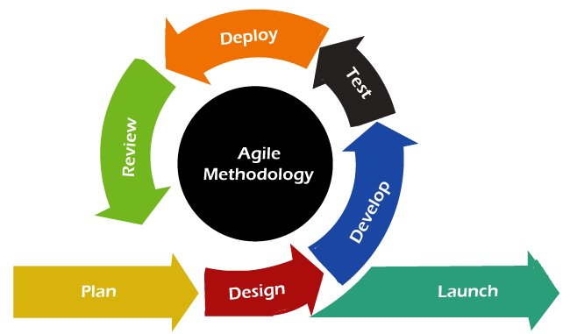
Agile
Agile is dead. Long live agility
Digital.ai 2023
40% reported organizational resistance to change.
33% pointed to lack of leadership support.
only ~31% of Agile projects are considered “successful”

Slide 5
Software Success
Dream/utopia?
Standish Group CHAOS Report (2020):
Only 31% of software projects are considered successful (on time, on budget, with required features).
52% are “challenged,” and 17% outright fail.
McKinsey & Oxford Study on IT project failures:
The average large IT project runs 45% over budget, 7% over time, and delivers 56% less value than predicted.

Slide 6
Code Design — Where System Architecture Becomes Reality
The Bridge Between Planning and Working Software
01
Code Design
System Design
Development Process
03
02
Software Architecture
Notes:
🔗 From Architecture to Code
🏗️ System Design defines structure
🧭 Software Architecture defines responsibilities
💡 Code Design implements behavior, maintainability, and testability
❌ Without Good Code Design
The system becomes hard to evolve
Teams misunderstand the original architecture
Technical debt grows fast — killing your architectural effort
❌ Without Good Code Design
The system becomes hard to evolve
Teams misunderstand the original architecture
Technical debt grows fast — killing your architectural effort

Slide 7
The ROI of Good Code Design
Proven Gains from Clean, Modular, and Maintainable Code
🚀 20–30% faster delivery
💸 50% reduction in time spent on maintenance
📉 Reduction in defects by 60%+
McKinsey DevEx Study
🚀 Deploy 208x more frequently
⚡ Recover 106x faster from failures
❌ Have 7x lower change failure rates
Dora Report
Saves 3x development effort over time
Reduces onboarding time by up to 50%
Microsoft Report
Notes:
https://www.microsoft.com/en-us/research/wp-content/uploads/2025/06/Code_Researcher-1.pdf

Slide 8
The ROI of Good Code Design
Proven Gains from Clean, Modular, and Maintainable Code
Source | Metric | Impact
McKinsey | Maintenance effort | ↓ 50% with clean architecture
DORA Report | Change failure rate | ↓ 7x with good engineering practices
Google | Deployment frequency | ↑ 208x with modular, testable code
Microsoft | Onboarding new devs on clean codebase | ↓ 50% time to ramp up
Notes:
https://www.microsoft.com/en-us/research/wp-content/uploads/2025/06/Code_Researcher-1.pdf

Slide 9
KISS — Keep It Simple, Stupid
Simplicity Is the Ultimate Sophistication
"Keep It Simple, Stupid" is a principle that reminds us to avoid unnecessary complexity.
— Coined by the U.S. Navy in 1960
"Any fool can write code that a computer can understand. Good programmers write code that humans can understand." — Martin Fowler
Notes:
https://www.microsoft.com/en-us/research/wp-content/uploads/2025/06/Code_Researcher-1.pdf

Slide 10
KISS in Practice — Keep It Simple, Seriously
Complexity Is a Cost. Simplicity Is a Feature
🚨 Overkill Scenario | ✅ KISS Alternative
Creating an interface with one implementation | Use a class — refactor when needed
Adding a design pattern to "flex" or over-abstract | Just solve the problem clearly
Using a new library/feature just because it’s trendy | Prefer stability + team familiarity
Using Strategy for a one-off logic branch | A simple if statement may suffice
"The easiest code to maintain is the one you didn’t have to write."
— KISS Principle, distilled
Notes:
https://www.microsoft.com/en-us/research/wp-content/uploads/2025/06/Code_Researcher-1.pdf

Slide 11
Simplicity as efficiency
Fight against complexity
Abstractions interfaces “ I might need this later” this is what the experts do
Code complexity
Design patterns
Simplicity
Oop everywhere
Starting to code
Years of programming

Slide 12
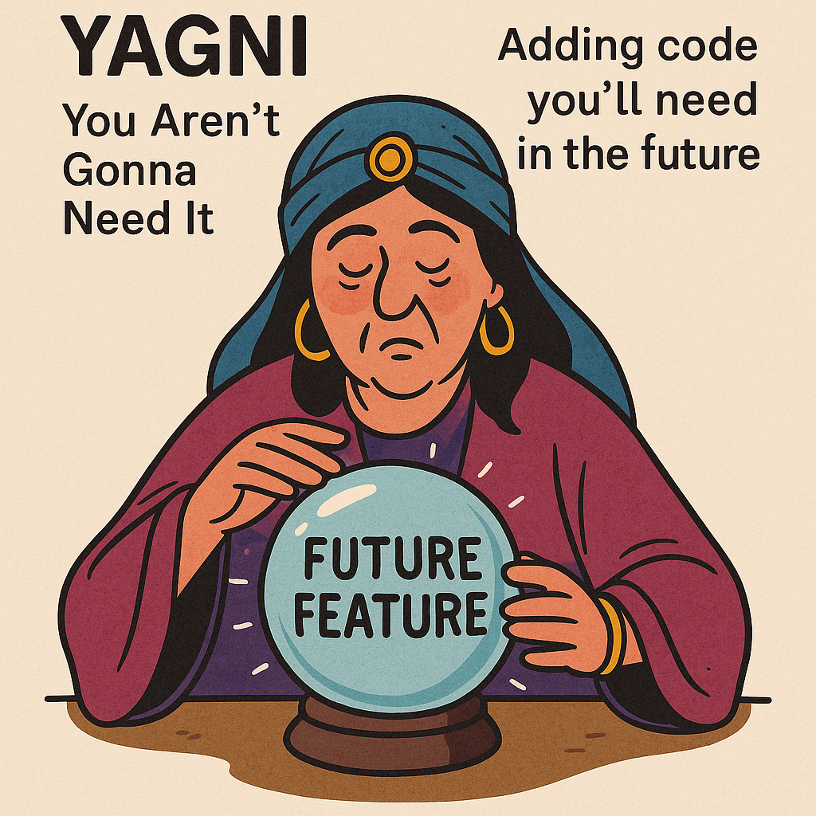
YAGNI — You Aren’t Gonna Need It
Don’t Build What You Don’t Need (Yet)
“You Aren’t Gonna Need It” is a principle from Extreme Programming (XP)
It warns against building features, abstractions, or logic "just in case."
"Premature optimization is the root of all evil" Donald Knuth

Slide 13
DRY — Don’t Repeat Yourself
Reuse Knowledge, Not Just Code
Every piece of knowledge must have a single, authoritative representation in your code. — The Pragmatic Programmer
class CheckoutService {
BigDecimal calculateFinalPrice(BigDecimal price) {
return price.subtract(price.multiply(BigDecimal.valueOf(0.10))); // Duplicated logic
}
}
class PromotionService {
BigDecimal promoPrice(BigDecimal price) {
return price.subtract(price.multiply(BigDecimal.valueOf(0.10))); // Again?!
}
}

Slide 14
Make a Type — Embrace the Rich Model
Don’t Pass Primitives When You Mean Concepts
❌ The Primitive Obsession Smell
Situation | Make a Type?
Value needs validation | ✅ Yes
Appears in multiple places | ✅ Yes
Has domain-specific behavior | ✅ Yes
Improves clarity of function/method | ✅ Yes
Primitive passed with no meaning | ⚠️ Likely

Slide 15
Make a Type — Embrace the Rich Model
Don’t Pass Primitives When You Mean Concepts
❌ The Primitive Obsession Smell
Situation | Make a Type?
Value needs validation | ✅ Yes
Appears in multiple places | ✅ Yes
Has domain-specific behavior | ✅ Yes
Improves clarity of function/method | ✅ Yes
Primitive passed with no meaning | ⚠️ Likely

Slide 16
Make a Type — Embrace the Rich Model
Don’t Pass Primitives When You Mean Concepts
class Discount {
public static final Discount NONE = new Discount("No Discount", 0.0);
private final String reason;
private final double rate;
public MonetaryAmount applyTo(MonetaryAmount price) {
return price.multiply(1.0 - rate);
}
}
class CheckoutService {
public MonetaryAmount calculateFinalPrice(MonetaryAmount price, Discount discount) {
return discount.applyTo(price);
}
}

Slide 17
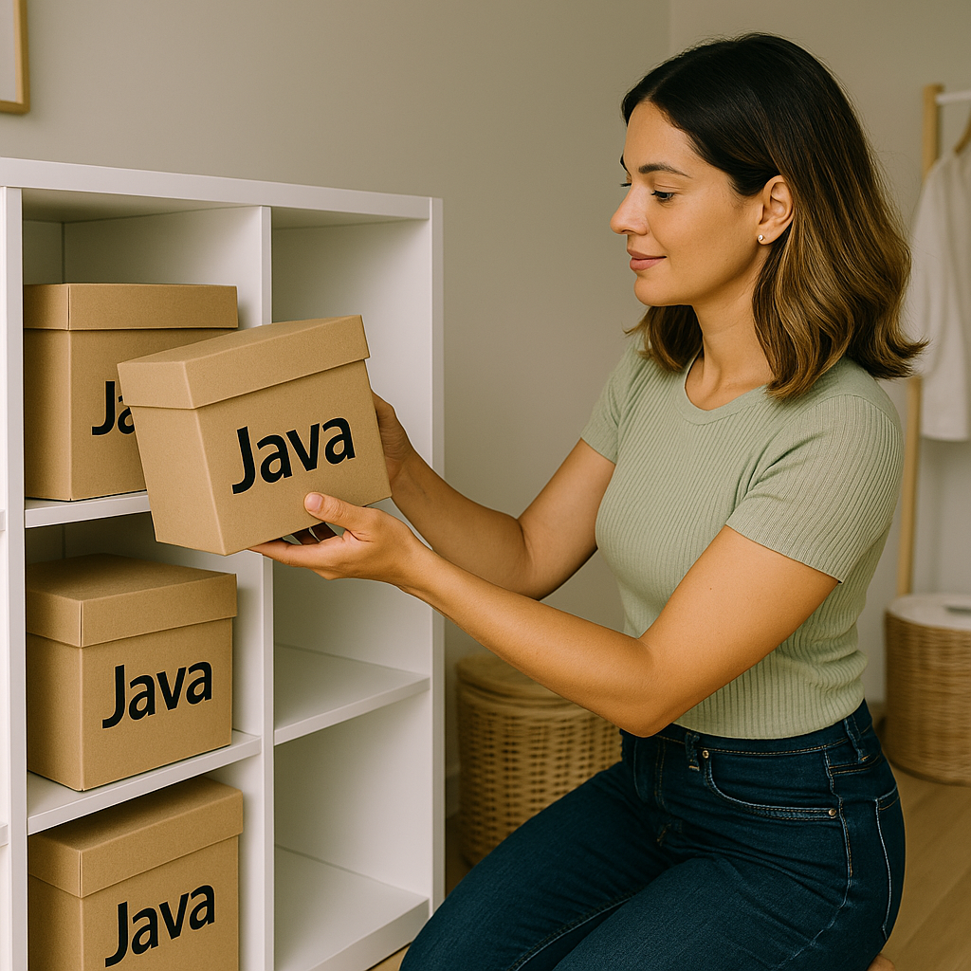
Separation of Concerns (SoC)
Divide Responsibilities, Multiply Clarity
Concern | Belongs to…
📡 API routing | Controller / Endpoint
🧠 Business logic | Service layer
💾 Persistence handling | Repository / DAO
🎨 View rendering | Front-end or template engine
🔐 Authentication | Middleware or filter
“When everything is responsible for everything, nothing is responsible for anything.”

Slide 18
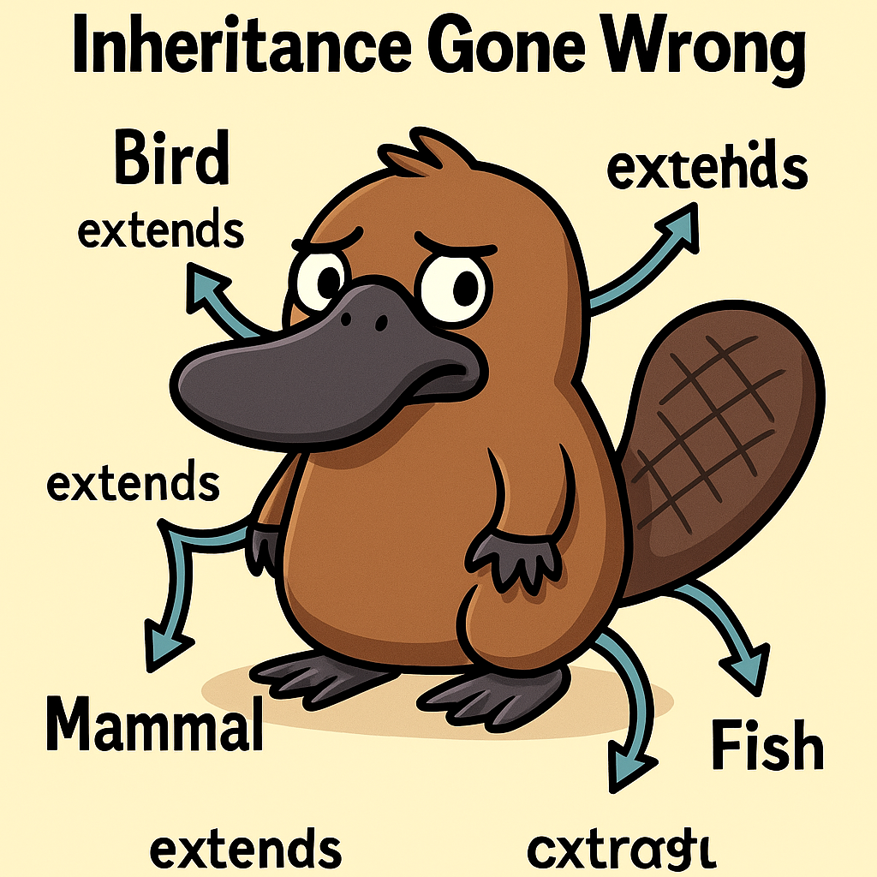
Composition Over Inheritance
Favor Flexibility and Reusability Over Fragile Hierarchies
Prefer “has-a” relationships over “is-a” when modeling behavior.
class Sea {
boolean hasSalt() { return true; }
}
class Cake extends Sea {
// 🤯 Makes no semantic sense
}

Slide 19
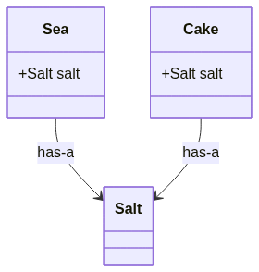
Composition Over Inheritance
Favor Flexibility and Reusability Over Fragile Hierarchies
Prefer “has-a” relationships over “is-a” when modeling behavior.
class Salt {}
class Sea {
Salt salt = new Salt();
}
class Cake {
Salt salt = new Salt();
}

Slide 20
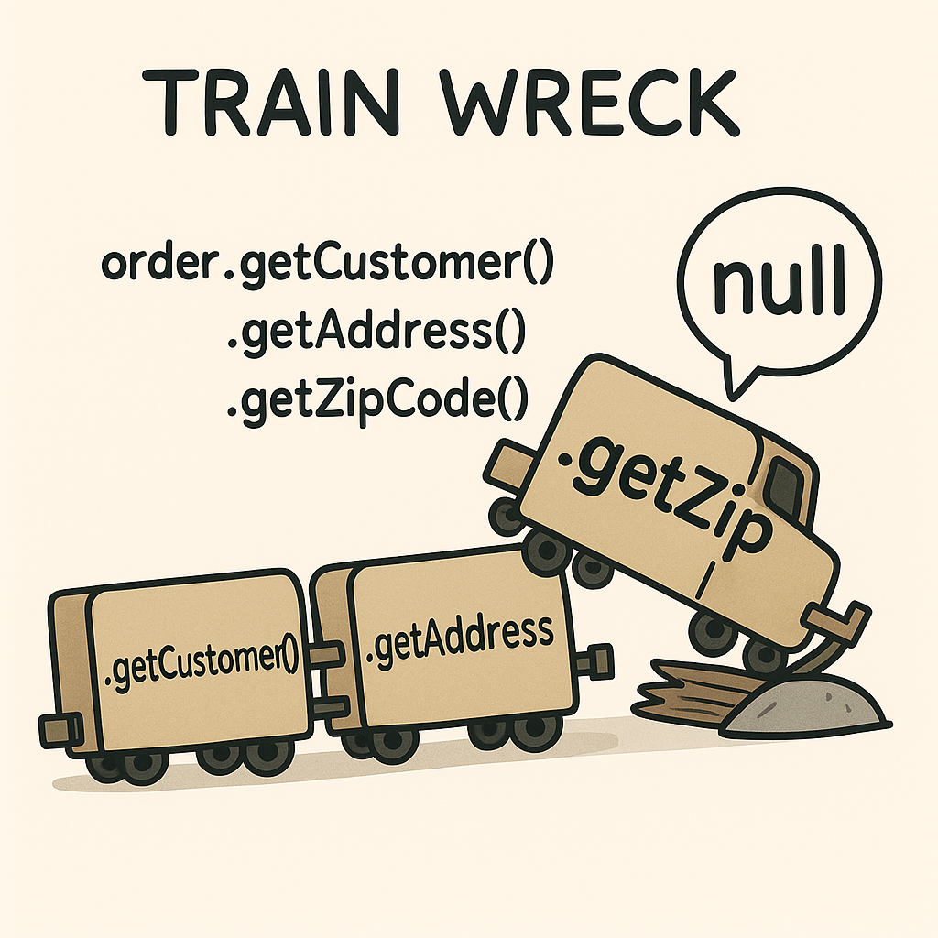
Law of Demeter — Principle of Least Knowledge
Talk to Friends, Not Strangers
❌
order.getCustomer().getAddress().getZipCode();
✅
order.getZipCode();
Notes:
✅

Slide 21

Coupling and Cohesion
How Tightly Should Things Be Connected?
Cohesion: How closely related the responsibilities of a module/class are.
Coupling: How much one module/class depends on others to function.
Principle | Desired Level | Description
Cohesion | 🔼 High | A module focuses on one clear task
Coupling | 🔽 Low | Modules know as little as possible about others
Notes:
✅

Slide 22
When Cohesion Fails: The God Service Class
The Cost of Doing Everything in One Place
class UserService {
void registerUser(...) // ✅ user logic
void sendWelcomeEmail(...) // ❌ mail logic
void generatePdfReport(...) // ❌ reporting logic
void scheduleUserSync(...) // ❌ async/integration
void logUserHistory(...) // ❌ logging concern
}
Notes:
✅

Slide 23
Encapsulation
Control Access, Prevent Leaks, and Evolve Safely
public class Order {
private final List<Item> items = new ArrayList<>();
public void addItem(Item item) {
// validation, pricing rules, etc.
items.add(item);
}
public List<Item> getItems() {
return Collections.unmodifiableList(items);
}
}

Slide 24
SOLID Principles
Five Pillars of Object-Oriented Software Design
Letter | Principle | Focus
S | Single Responsibility Principle | One reason to change
O | Open/Closed Principle | Open for extension, closed for modification
L | Liskov Substitution Principle | Subtypes must behave like their base type
I | Interface Segregation Principle | Don’t force unused methods
D | Dependency Inversion Principle | Depend on abstractions, not concretions

Slide 25
Code Readability & Maintainability
If You Can't Read It, You Can't Trust It
"Code is read more often than it is written." — Robert C. Martin
🔄 Adapt to new requirements
🔍 Be tested and validated
♻️ Be refactored without fear
👥 Be handled by people other than the author

Slide 26
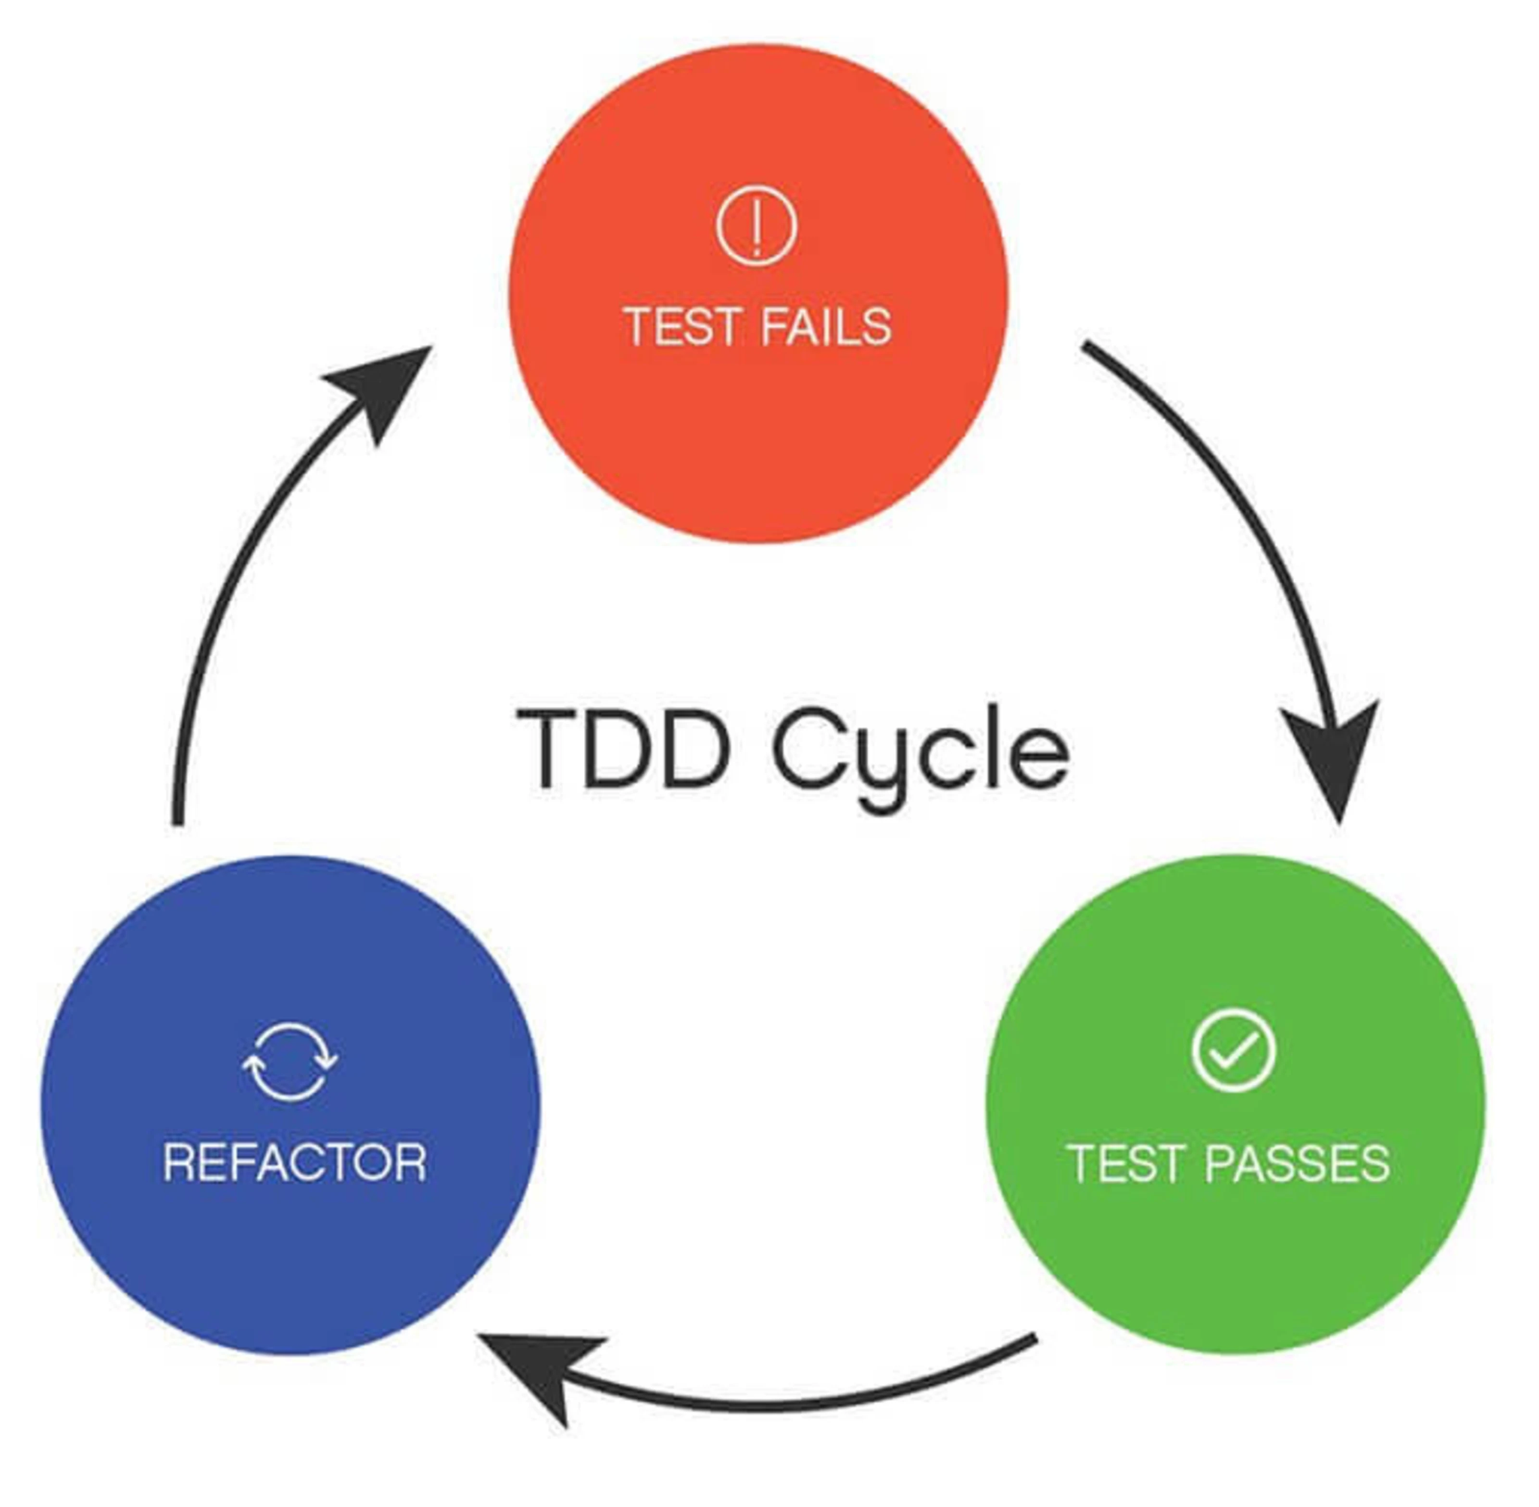
Testability & TDD — Build Confidence, Not Just Features
Well-Designed Code Is Testable Code
🔄 Safe refactoring
🚨 Fast feedback loops
🧠 Design clarity through modularity

Slide 27
Refactoring & Code Smells
Clean the Smell Before It Becomes a Fire
Refactoring is the process of improving code structure without changing its external behavior.
Code Smells are symptoms of poor design that suggest deeper problems.
Smell Name | Symptom
🚨 God Class | One class does too many unrelated things
💬 Long Method | Huge, unreadable methods
🔁 Duplicate Logic | Same code appears in many places
🧪 Hard-to-Test Code | Tight coupling and hidden dependencies
⚠️ Primitive Obsession | Using raw types instead of domain objects

